Slide 1
University physics, classical mechanics, Lecture 10. Still Lesson 7: Rotation of rigid bodies
Teacher: Dr. Paul Briard
Wechat: Paulbg123

Slide 2
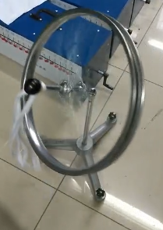

The precession phenomenon
Pivot (O)
$$\vec{L}$$
If we give an initial angular momentum to the wheel about its axis, the wheel spins around O, i.e. it has 2 rotational motions, one around its axis, and one around the pivot O.
With no initial angular momentum, the wheel is falling
Notes:
PARLER LENTEMENT: Here is another example. The wheel can be putted on a support at the pivot point O. The axis of rotation of the wheel is also axis of symmetry, the angular momentum of the wheel about point O is also the axis of the wheel. We can consider two kinds of situations. We can give or not an initial angular momentum to the wheel or not, which results in two kinds of motion. If we don’t give an initial angular momentum to the will, the wheel will simply falling. If we give an initial momentum to the wheel, when we put the wheel on the support, the wheel will have two rotational motion, one rotational motion around its axis, and one rotational motion around the pivot point O. In that case, the axis of wheel will rotate, which means its angular momentum will also rotates. This phenomenon is named the “precession” and is what we want to describe.

Slide 3
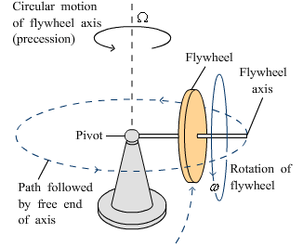
The precession phenomenon
A flywheel spinning at angular velocity $ω$ is connected to a pivot.
The flywheel turns also around the pivot, at precession angular velocity $Ω$
This phenomenon is named precession.
Notes:
PARLER LENTEMENT: Here is another figure with a flywheel, where the both rotational motion are shown. The axis of the flywheel is putted on the pivot. If the rotation of flywheel is fast enough, the flywheel will not fall, even if the axis of the flywheel is almost horizontal. The rotational motion around the axis of the flywheel is described by the angular velocity lowercase omega. The rotational motion of the flywheel around the pivot point has angular velocity uppercase omega. This rotational motion is the precession, i.e. the rotational motion of the axis of the wheel.

Slide 4
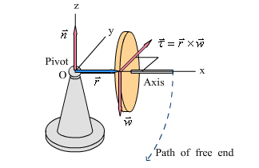
The precession phenomenon
If the flywheel is not spinning, its falls (along a circular path)
We consider the system “flywheel” (the wheel +axis)
Notes:
PARLER LENTEMENT: But first, let’s describe the motion of the wheel if we don’t give it an initial angular momentum. The consider the system flywheel corresponding to the wheel and its axis, O is at the pivot. Ox is directed along the axis of the wheel. If the wheel doesn’t spin because we don’t git it an initial angular momentum, the wheel fall along a circular path.

Slide 5


The precession phenomenon
If the flywheel is not spinning, its falls (along a circular path)
We consider the system “flywheel” (the wheel +axis)
Normal force $\vec{n}$ (applied at O):
$$no torque about the pivot (O)$$
Notes:
PARLER LENTEMENT: Let’s see what is the net torque on the will. The flywheel is putted on the support at the pivot point O. There is a normal force exerted on the flywhell applied at O, but no torque about O exerted by the normal force.

Slide 6



The precession phenomenon
If the flywheel is not spinning, its falls (along a circular path)
We consider the system “flywheel” (the wheel +axis)
Normal force $\vec{n}$ (applied at O):
$$no torque about the pivot (O)$$
Weight $\vec{w}$ (directed toward the $−z$-direction):
$$torque about the pivot (O)$$
$$\vec{τ}=\vec{r}×\vec{w}$$
where the weight is applied at the center of mass (at distance $r$ from O)
Notes:
PARLER LENTEMENT: There is also a weight exerted on the flywheel. The direction of the weight is the –z-direction. The weigh doesn’t exert a torque about the center of mass of the flywheel, but it exerts a torque about the pivot point O, which is described by position vector r and the weight w.

Slide 7

The precession phenomenon
If the flywheel is not spinning, its falls (along a circular path)
We consider the system “flywheel” (the wheel +axis)
Normal force $\vec{n}$ (applied at O):
$$no torque about the pivot (O)$$
Weight $\vec{w}$ (directed toward the $−z$-direction):
$$torque about the pivot (O)$$
$$\vec{τ}=\vec{r}×\vec{w}$$
where the weight is applied at the center of mass (at distance $r$ from O)
Net torque on the flywheel about the pivot:
$$\vec{τ}=\vec{r}×\vec{w}$$
Notes:
PARLER LENTEMENT: Thus, if we ignore friction, the net torque about O exerted on the flywheel is the torque by the weight about O.

Slide 8



The precession phenomenon
If the flywheel is not spinning initially, its falls (along a circular path)
Net torque on the flywheel:
directed in the +y-direction
$$\vec{τ}=\vec{r}×\vec{w}$$
If the wheel is not spinning initially :
$${\vec{L}}_{i}=\vec{0}$$
The change of its angular momentum during $dt$ is directed in +y direction:
$$d\vec{L}=\vec{τ}dt$$
$\left|\vec{L}\right|$ increase with the time but its direction remains the same.
Rotation around the y-axis (path of free end)
Notes:
PARLER LENTEMENT: We consider as initial time the time where we put the wheel on the support, it will have a circular notion. The initial angular momentum of the wheel about O is zero, but because of the net torque exerted on the wheel, there will be change of its angular momentum. The change of angular momentum is directed along the +y_direction because the net torque is directed along the +y-direction, as shown on the figure. The result is a rotation around the t

Slide 9





The precession phenomenon
$$z$$
$$y$$
$$\vec{τ}$$
$$x$$
If the flywheel is spinning initially
Its initial angular momentum is ${\vec{L}}_{i}≠\vec{0}$
${\vec{L}}_{i}$ is directed toward the $+$x-direction
Notes:
PARLER LENTEMENT: Now we consider that the flywheel has an initial angular momentum which is directed along the x-axis, the flywheel rotates around the x-axis.

Slide 10





The precession phenomenon
$$z$$
$$y$$
$$\vec{τ}$$
$$x$$
If the flywheel is spinning initially
Its initial angular momentum is ${\vec{L}}_{i}≠\vec{0}$
${\vec{L}}_{i}$ is directed toward the $+$x-direction
The net torque about pivot point on the flywheel is directed toward the $+y$-direction
Notes:
PARLER LENTEMENT: The net torque on the flywheel about pivot point is directed toward the +-y direction, as shown on the figure. The net torque is the torque done by the weight about pivot point because the normal force exert no torque about pivot point and the friction is ignored.

Slide 11
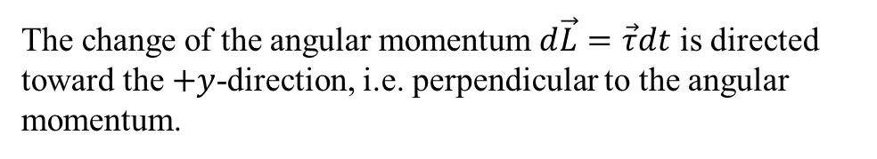
The precession phenomenon
$$z$$
$$y$$
$$\vec{τ}$$
$$x$$
If the flywheel is spinning initially
Its initial angular momentum is ${\vec{L}}_{i}≠\vec{0}$
${\vec{L}}_{i}$ is directed toward the $+$x-direction
The net torque on the flywheel is directed toward the $+y$-direction
The change of the angular momentum $d\vec{L}=\vec{τ}dt$ is directed toward the $+y$-direction, i.e. perpendicular to the angular momentum.
Notes:
PARLER LENTEMENT: So, we can describe the infinitesimal change of angular momentum which is also directed toward the +y-direction. So the change of angular momentum is perpendicular with the direction of the angular momentum.

Slide 12







The precession phenomenon
$$z$$
$$y$$
$$\vec{τ}$$
$$y$$
$$\vec{τ}$$
$$z$$
$$⨀$$
$$d\vec{L}$$
$$x$$
$${\vec{L}}_{i}$$
$$x$$
If the flywheel is spinning initially
Its initial angular momentum is ${\vec{L}}_{i}≠\vec{0}$
${\vec{L}}_{i}$ is directed toward the $+$x-direction
The net torque on the flywheel is directed toward the $+y$-direction
The change of the angular momentum $d\vec{L}=\vec{τ}dt$ is directed toward the $+y$-direction, i.e. perpendicular to the angular momentum.
Notes:
PARLER LENTEMENT: At the right is a figure which shown the angular momentum at a time t, the net torque about pivot point and the infinitesimal change of angular momentum. Thus we can describe the angular momentum at time t+dt, it is the initial angular momentum at time t, plus its infinitesimal change.

Slide 13

The precession phenomenon
$$z$$
$$y$$
$$\vec{τ}$$
$$y$$
$$\vec{τ}$$
$${\vec{L}}_{i}+d\vec{L}$$
$$z$$
$$⨀$$
$$d\vec{L}$$
$$x$$
$${\vec{L}}_{i}$$
$$x$$
If the flywheel is spinning initially
Its initial angular momentum is ${\vec{L}}_{i}≠\vec{0}$
${\vec{L}}_{i}$ is directed toward the $+$x-direction
The net torque on the flywheel is directed toward the $+y$-direction
The change of the angular momentum $d\vec{L}=\vec{τ}dt$ is directed toward the $+y$-direction, i.e. perpendicular to the angular momentum.
Notes:
PARLER LENTEMENT: We obtain an angular momentum which has rotated around the z-axis. Its magnitude stays constant, but its direction change according to a circular motion around the z-axis.

Slide 14
The precession phenomenon
$$z$$
$$y$$
$$\vec{τ}$$
$$y$$
$$\vec{τ}$$
$${\vec{L}}_{i}+d\vec{L}$$
$$z$$
$$⨀$$
$$d\vec{L}$$
$$x$$
$${\vec{L}}_{i}$$
$$x$$
Rotation of the angular momentum around the z-axis
Precession
If the flywheel is spinning initially
Its initial angular momentum is ${\vec{L}}_{i}≠\vec{0}$
${\vec{L}}_{i}$ is directed toward the $+$x-direction
The net torque on the flywheel is directed toward the $+y$-direction
The change of the angular momentum $d\vec{L}=\vec{τ}dt$ is directed toward the $+y$-direction, i.e. perpendicular to the angular momentum.
Notes:
PARLER LENTEMENT: So, we can describe the whole rotation of the angular momentum as we did previously. This phenomenon is the precession.

Slide 15








The precession phenomenon
$$z$$
$$y$$
$$\vec{τ}$$
$$y$$
$$\vec{τ}$$
$${\vec{L}}_{i}+d\vec{L}$$
$$z$$
$$⨀$$
$$d\vec{L}$$
$$x$$
$${\vec{L}}_{i}$$
$$x$$
Rotation of the angular momentum around the z-axis
Precession
If the flywheel is spinning initially
If there was no friction, the direction of $\vec{L}$ change but not its magnitude, and the flywheel could turn around the z-axis indefinitely.
Notes:
PARLER LENTEMENT: If there was no friction, the direction of the angular momentum change, and rotates around the z-axis. However, there is always friction. What happens in that case ?

Slide 16
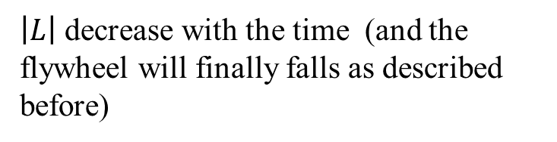
The precession phenomenon
$$z$$
$$y$$
$$\vec{τ}$$
$$y$$
$$\vec{τ}$$
$${\vec{L}}_{i}+d\vec{L}$$
$$z$$
$$⨀$$
$$d\vec{L}$$
$$x$$
$${\vec{L}}_{i}$$
$$x$$
Rotation of the angular momentum around the z-axis
Precession
If the flywheel is spinning initially
If there was no friction, the direction of $\vec{L}$ change but not its magnitude, and the flywheel could turn around the z-axis indefinitely.
But there is always friction
$\left|L\right|$ decrease with the time (and the flywheel will finally falls as described before)
Notes:
PARLER LENTEMENT: Because of the friction, the magnitude of the angular momentum will decrease, and finally the flywheel will fall, which is the same motion that what we have described when we don’t give to the flywheel an initial angular momentum.

Slide 17




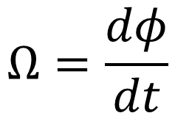




Precession angular speed
$$y$$
$$\vec{τ}$$
$$\vec{L}+d\vec{L}$$
$$d\vec{L}$$
$$z$$
$$⨀$$
$$dφ$$
$$x$$
The precession angular speed is the angular speed at which the angular momentum turns around the z-axis:
$$Ω=\frac{dφ}{dt}$$
Notes:
PARLER LENTEMENT: Now, lets see if we can describe the angular velocity of the rotation of the angular momentum. The rotation of the angular momentum between times t and t+dt is described by the angle d_phi,

Slide 18

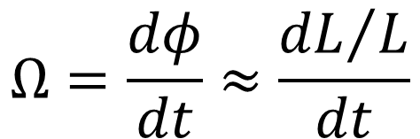

Precession angular speed
$$y$$
$$\vec{τ}$$
$$\vec{L}+d\vec{L}$$
$$d\vec{L}$$
$$z$$
$$⨀$$
$$dφ$$
$$\vec{L}$$
$$x$$
The precession angular speed is the angular speed at which the angular momentum turns around the z-axis:
$$\tan{dφ=\frac{dL}{L}≈dφ}$$
$$Ω=\frac{dφ}{dt}≈\frac{{dL}/L}{dt}$$
Notes:
PARLER LENTEMENT: As you see on the figure, the infinitesimal angle phi is the ratio between the infinitesimal change of momentum dL and the magnitude of the momentum. You see that appears the change rate of the angular momentum.

Slide 19
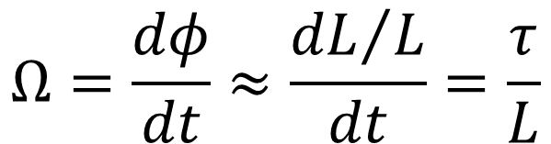
Precession angular speed
$$y$$
$$\vec{τ}$$
$$\vec{L}+d\vec{L}$$
$$d\vec{L}$$
$$z$$
$$⨀$$
$$dφ$$
$$\vec{L}$$
$$x$$
The precession angular speed is the angular speed at which the angular momentum turns around the z-axis:
Net torque on the flywheel about O
$$Ω=\frac{dφ}{dt}≈\frac{{dL}/L}{dt}=\frac{τ}{L}$$
Angular momentum of the flywheel about O
Notes:
PARLER LENTEMENT: This change rate of the angular momentum is also the net torque exerted on the flywheel about O. We obtain that the angular velocity of the rotation of the angular momentum is the net torque divided by the angular momentum.

Slide 20


Precession angular speed
$$y$$
$$\vec{τ}$$
$$\vec{L}+d\vec{L}$$
$$d\vec{L}$$
$$z$$
$$⨀$$
$$dφ$$
$$\vec{L}$$
$$x$$
The precession angular speed is the angular speed at which the angular momentum turns around the z-axis:
Net torque on the flywheel about O
$$Ω=\frac{dφ}{dt}≈\frac{{dL}/L}{dt}=\frac{τ}{L}$$
Angular momentum of the flywheel about O
with
$$τ=\left|\vec{r}×\vec{w} \right|=rw$$
and
$$L=Iω$$
(because axis of rotation is an axis of symmetry )
Distance between O and the center of mass of the flywheel
Notes:
PARLER LENTEMENT: And we can describe the net torque as the distance r multiplied by the weight exerted on the fly wheel. The axis of rotation of the flywheel is also an axis of symmetry of the flywheel, which means its angular moment is the moment of inertia of the flywheel about its axis multiplied by it angular velocity.

Slide 21







Precession angular speed
$$z$$
$$y$$
$$\vec{τ}$$
$$x$$
with
$$τ=\left|\vec{r}×\vec{w} \right|=rw$$
and
$$L=Iω$$
(because axis of rotation is an axis of symmetry )
$$Ω=\frac{rw}{Iω}$$
You don’t need to remember this expression, but you must be able to find it by yourself.
Notes:
PARLER LENTEMENT: Thus, we obtain the corresponding angular velocity of rotation of the angular momentum of the flywheel

Slide 22
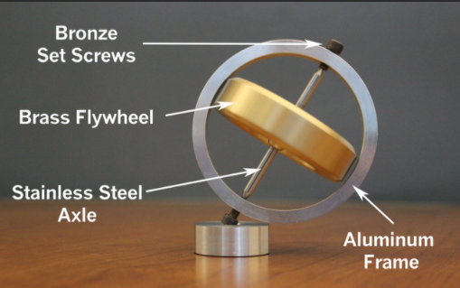
Principle of gyroscope
An example of gyroscope for demonstration.
Using of a gyroscope is based on their precession.
Gyroscopes are used (paired with accelerometer) in navigation systems of aircraft, ships, spacecraft satellites.
They measure orientation and angular velocities.
Notes:
PARLER LENTEMENT: The precession is related with the gyroscope. The using of a gyroscope is based on their precession, they are paired with an accelerometer for navigation by aircrafts, shipts, and so on. They permit to measure orientations and angular velocities.

Slide 23
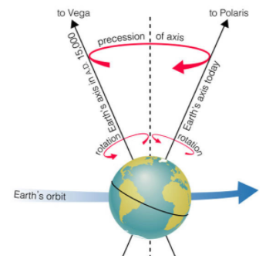
Precession of planets
Planets have precession associated with their rotational motion.
“The precession of Earth's spin axis has a profound effect on Earth's climate. Precession is involved with the approach of perihelion (the closest approach to the Sun)” [1]
[1] https://www.sciencedirect.com/topics/earth-and-planetary-sciences/precession
Notes:
PARLER LENTEMENT: The planets have also precession. The axis of rotation of a planet around itself has a precession, has shown in this figure. Precession is involved with the approach of perihelion, which is the closest approach to the sun by a planet, which is something I will describe you later in details.

Slide 24
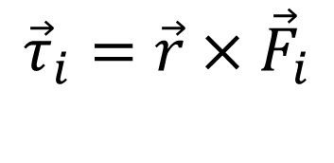
Summary
torque (by the force $\vec{F_{i}}$) of about a point O applied at distance $r$ from this point:
$${\vec{τ}}_{i}=\vec{r}×{\vec{F}}_{i}$$
Notes:
PARLER LENTEMENT: Here is a summary of the important concepts we have seen about rotation of rigid bodies. First we, have described what is a torque about a point.

Slide 25
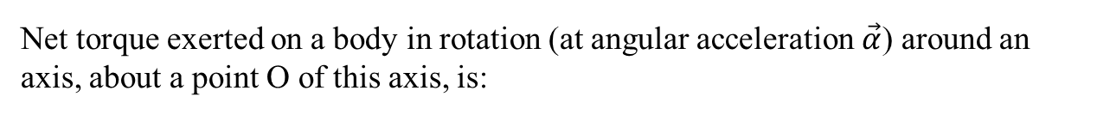
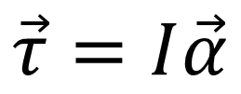
Summary
torque (by the force $\vec{F_{i}}$) of about a point O applied at distance $r$ from this point:
$${\vec{τ}}_{i}=\vec{r}×{\vec{F}}_{i}$$
Net torque exerted on a body in rotation (at angular acceleration $\vec{α}$) around an axis, about a point O of this axis, is:
$$\vec{τ}=I\vec{α}$$
Notes:
PARLER LENTEMENT: Then we have described the rotational analogy of the Newton second law, the net torque about a point of the axis of rotation of a body is the product between the moment of inertia of the body about its axis of rotation and its angular acceleration vector.

Slide 26
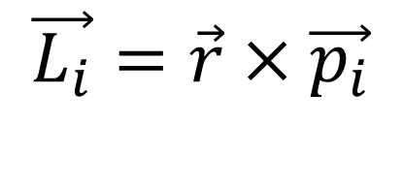
Summary
torque (by the force $\vec{F}$) of about a point O applied at distance $r$ from this point:
$${\vec{τ}}_{i}=\vec{r}×{\vec{F}}_{i}$$
Net torque exerted on a body in rotation (at angular acceleration $\vec{α}$) around an axis, about a point O of this axis, is:
$$\vec{τ}=I\vec{α}$$
Angular momentum of a particle of momentum $\vec{p_{i}}$ about a point O, at distance $r$ from this point:
$$\vec{L_{i}}=\vec{r}×\vec{p_{i}}$$
Notes:
PARLER LENTEMENT: We have also described the angular momentum of a particle about a point O, it is the vector product between its position vector about point O and its linear momentum.

Slide 27
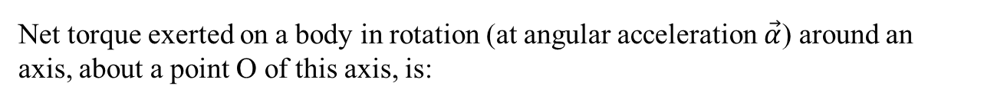
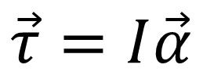
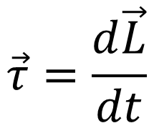

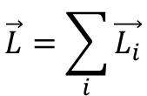
Summary
torque (by the force $\vec{F}$) of about a point O applied at distance $r$ from this point:
$${\vec{τ}}_{i}=\vec{r}×{\vec{F}}_{i}$$
Net torque exerted on a body in rotation (at angular acceleration $\vec{α}$) around an axis, about a point O of this axis, is:
$$\vec{τ}=I\vec{α}$$
Angular momentum of a particle of momentum $\vec{p_{i}}$ about a point O, at distance $r$ from this point:
$$\vec{L_{i}}=\vec{r}×\vec{p_{i}}$$
The net torque on a rigid body about a point O is the change rate of the total angular momentum about the point O:
$$\vec{τ}=\frac{d\vec{L}}{dt}$$
where
$$\vec{L}=\sum_{i}{\vec{L_{i}}}$$
Notes:
PARLER LENTEMENT: We have described that the net torque on a body about a point is the change rate of its angular momentum. This law can also be seen as a rotational analogy of the Newton second law.

Slide 28
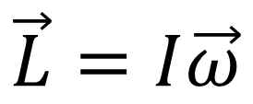
Summary
If the axis of rotation is an axis of symmetry of the body, its angular momentum about a point O of this axis is directed toward the axis of rotation, and:
$$\vec{L}=I\vec{ω}$$
Angular velocity vector
Moment of inertia about the axis of rotation
Notes:
PARLER LENTEMENT: In the particular case where the axis of rotation is an axis of symmetry of the body, the angular momentum is the product between the moment of inertia around the axis of rotation and the angular velocity vector.

Slide 29
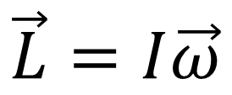
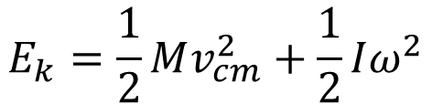
Summary
If the axis of rotation is an axis of symmetry of the body, its angular momentum about a point O of this axis is directed toward the axis of rotation, and:
$$\vec{L}=I\vec{ω}$$
Angular velocity vector
Moment of inertia about the axis of rotation
Total kinetic energy of a body in translational motion + rotational motion:
$$E_{k}=\frac{1}{2}Mv_{cm}^{2}+\frac{1}{2}Iω^{2}$$
Notes:
PARLER LENTEMENT: And we have also described the rotational kinetic energy. If a body has translational and rotational motion, we have to consider both translational and rotational kinetic energy. With all the analogies we have seen, if you remember the main formula about translational motion, it will be easy to remember the formula about the rotational motion.

Slide 30
End of lesson 7

Slide 31
Lesson 8: About the simple harmonic motion
Teacher: Dr. Paul Briard

Slide 32
Harmonic oscillations are a big topic in Physics
The sound is harmonic oscillations which propagates (oscillation of the local pressure).
The light is also the propagation of oscillations (of an electromagnetic field).
Any signal (such as electric signal: electric tension or intensity) is a sum of harmonic oscillations.
The description of the simple harmonic motion will be useful for us later.

Slide 33
Introduction: different kinds of periodic motion
The pendulum
Position of equilibrium

Slide 34
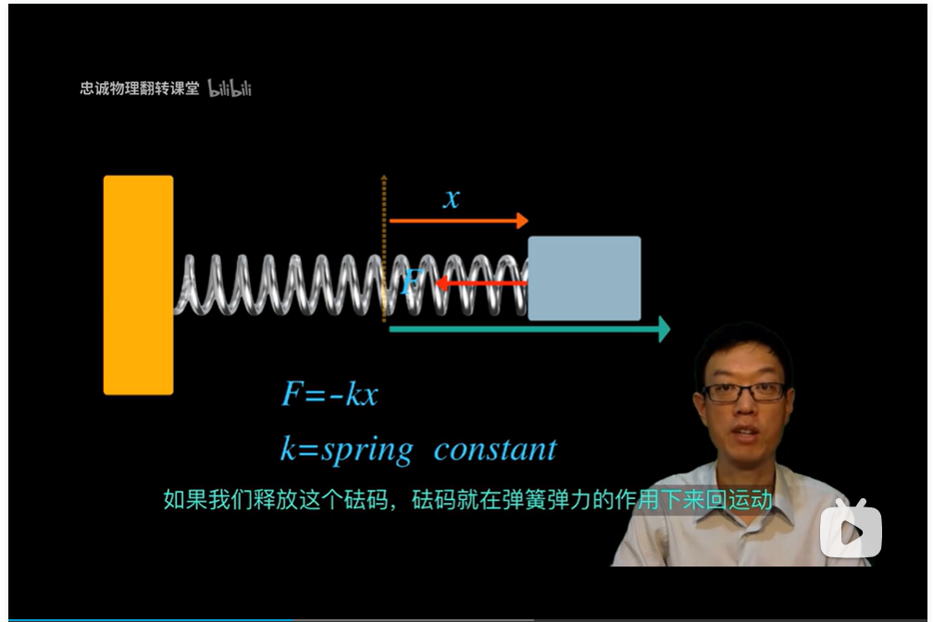
Introduction: different kinds of periodic motion
An horizontal (and then a vertical) spring-mass system
https://www.bilibili.com/video/BV1Fx411G7PU?from=search&seid=14076031412413100379&spm_id_from=333.337.0.0

Slide 35


Introduction: different kinds of periodic motion
A spring-mass system, at the vertical direction
Position of equilibrium

Slide 36
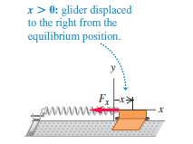
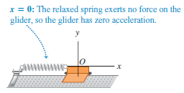
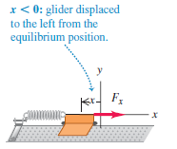
Introduction: different kinds of periodic motion
A spring-mass system, at the horizontal direction
We displace from equilibrium position the glider, then we release it with no-initial velocity. Friction is ignored. What is the motion of the glider ?

Slide 37
Summary: About a periodic motion
A body is displaced from an equilibrium position
A force (or sum of forces) is directed toward the equilibrium motion, which push or pull the body towards this equilibrium position.
But at the equilibrium position, the motion of body continues (because of the Newton’s first and second laws) until a position where its velocity is zero and go back toward the equilibrium position.
Periodic motion is involved with the forces acting on the body and the potential energy.

Slide 38
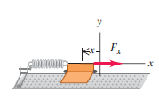
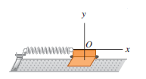





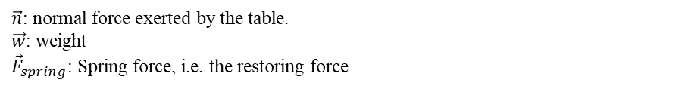







Description of a simple harmonic motion (SHM)
Middle of the glider is the x-coordinate of the glider. x=0 is the equilibrium position (i.e. , here the spring is not stretched or compressed)
$$x>0$$
$$x=0$$
$$x<0$$
Corresponding free body diagrams of the glider (friction ignored):
$$\vec{n}$$
$$\vec{n}$$
$$\vec{n}$$
$${\vec{F}}_{spring}$$
$${\vec{F}}_{spring}$$
$$\vec{w}$$
$$\vec{w}$$
$$\vec{w}$$
$\vec{n}$: normal force exerted by the table.
$\vec{w}$: weight
${\vec{F}}_{spring}$: Spring force, i.e. the restoring force

Slide 39





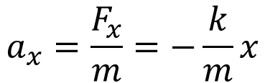
Description of a simple harmonic motion (SHM)
Using the Newton’s second law:
$$\vec{n}=−\vec{w}$$
$${\vec{F}}_{spring}=\vec{F}$$
where $\vec{F}=\vec{n}+\vec{w}+{\vec{F}}_{spring}$ is the net force on the glider.
The x-component of the force exerted by the spring (ideal, massless) on the glider is:
$$F_{spring,x}=F_{x}=−kx$$
(k is the spring coefficient)
The acceleration $\vec{a}$of the glider is described by (m is its mass):
$$m\vec{a}=\vec{F}$$
$$ma_{x}=F_{x}$$
We obtain a relation between the acceleration and the displacement from equilibrium:
$$a_{x}=\frac{F_{x}}{m}=−\frac{k}{m}x$$

Slide 40
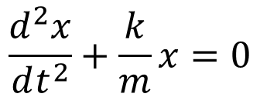
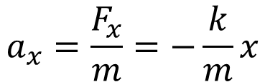
Description of a simple harmonic motion (SHM)
$$a_{x}=\frac{F_{x}}{m}=−\frac{k}{m}x$$
$$\frac{d^{2}x}{dt^{2}}+\frac{k}{m}x=0$$
This equation, where the acceleration is proportional to the displacement describe a “simple harmonic motion” or SHM
It is due to a restoring force proportional to the displacement from equilibrium.
It describes an oscillation around the equilibrium position.

Slide 41
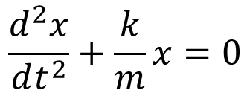
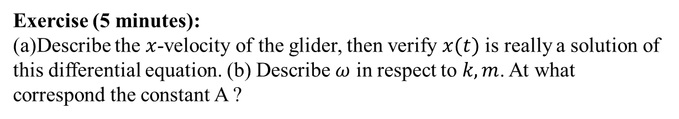

Description of a simple harmonic motion (SHM)
$$\frac{d^{2}x}{dt^{2}}+\frac{k}{m}x=0$$
Solutions of this equation are in the form (A, $ω, φ$ are constants, $A>0$, and by convention $ω>0$ ):
$$x\left(t\right)=A\cos\left(ωt+φ\right)$$
(I don’t describe now how we obtain the solutions, because it could be a bit complicated, I will say it later, when you will be more familiar with SHM )
Exercise (5 minutes):
(a)Describe the $x$-velocity of the glider, then verify $x(t)$ is really a solution of this differential equation. (b) Describe $ω$ in respect to $k,m$. At what correspond the constant A ?

Slide 42
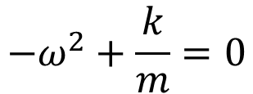

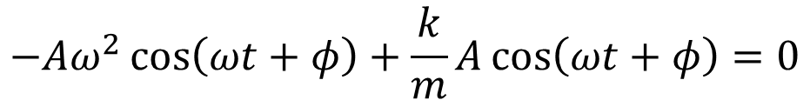
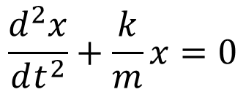
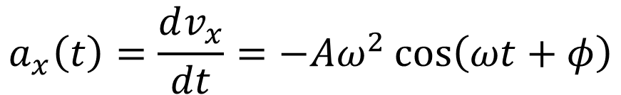
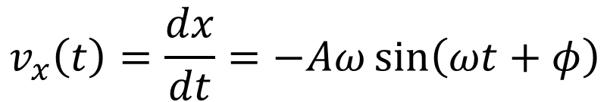

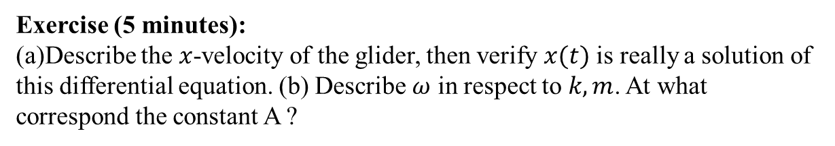
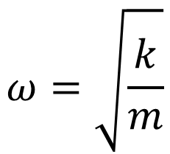
$$\frac{d^{2}x}{dt^{2}}+\frac{k}{m}x=0$$
$$x\left(t\right)=A\cos\left(ωt+φ\right)$$
Exercise (5 minutes):
(a)Describe the $x$-velocity of the glider, then verify $x(t)$ is really a solution of this differential equation. (b) Describe $ω$ in respect to $k,m$. At what correspond the constant A ?
$$v_{x}\left(t\right)=\frac{dx}{dt}=−Aω\sin\left(ωt+φ\right)$$
$$a_{x}\left(t\right)=\frac{dv_{x}}{dt}=−Aω^{2}\cos\left(ωt+φ\right)$$
$$−Aω^{2}\cos\left(ωt+φ\right)+\frac{k}{m}A\cos\left(ωt+φ\right)=0$$
$x\left(t\right)=A\cos\left(ωt+φ\right)$ is solution and,
$$ω=\sqrt{\frac{k}{m}}$$
$$−ω^{2}+\frac{k}{m}=0$$

Slide 43





$$\frac{d^{2}x}{dt^{2}}+\frac{k}{m}x=0$$
$$x\left(t\right)=A\cos\left(ωt+φ\right)$$
Exercise (5 minutes):
(a)Describe the $x$-velocity of the glider, then verify $x(t)$ is really a solution of this differential equation. (b) Describe $ω$ in respect to $k,m$. At what correspond the constant A ?
$$x\left(t\right)=A\cos\left(ωt+φ\right)$$
The maximum value of $\cos\left(ωt+φ\right)$ is$1$
$$x=A$$
The minimum value of $\cos\left(ωt+φ\right)$ is$−1$
$$x=−A$$
The glider oscillates between the positions $x=A$ and $x=−A$

Slide 44
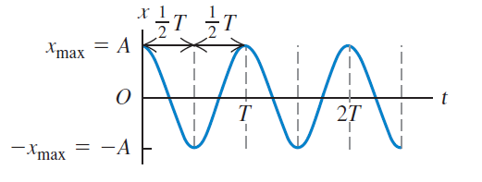
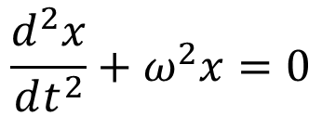

Description of a simple harmonic motion (SHM)
Single harmonic motion is the +x-direction is described by:
$$\frac{d^{2}x}{dt^{2}}+ω^{2}x=0$$
Solutions of this equation are in the form (A, $ω, φ$ are constants ), it is named also “sinusoidal motion”:
$$x\left(t\right)=A\cos\left(ωt+φ\right)$$

Slide 45


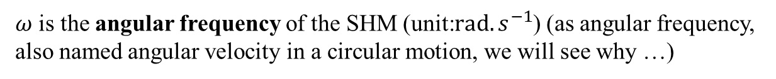
Description of a simple harmonic motion (SHM)
Solutions of this equation are in the form (A, $ω, φ$ are constants ), it is named also “sinusoidal motion”:
$$x\left(t\right)=A\cos\left(ωt+φ\right)$$
A is the amplitude of the SHM (SI unit: m), corresponding to extremum of displacement.
$ω$ is the angular frequency of the SHM (unit:$rad.s^{−1}$) (as angular frequency, also named angular velocity in a circular motion, we will see why …)
$T=\frac{2π}{ω}$ is the period of the SHM (unit: s)

Slide 46


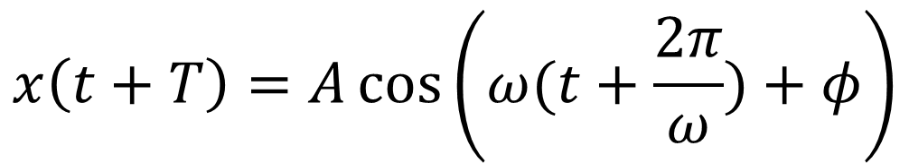
About the period of a SHM
$$x\left(t\right)=A\cos\left(ωt+φ\right)$$
$$x\left(t+T\right)=A\cos\left(ω(t+T)+φ\right)$$
$$x\left(t+T\right)=A\cos\left(ω(t+\frac{2π}{ω})+φ\right)$$
$$x\left(t+T\right)=A\cos\left(ωt+2π+φ\right)$$
$$x\left(t+T\right)=A\cos\left(ωt+φ\right)=x(t)$$
After a period T (we say also “after a cycle”), the body in SHM has returns to the same displacement, velocity, and acceleration (it is possible because friction has been ignored)
Number of cycles per second is the frequency (unit: Hz )
$$f=1/T$$

Slide 47




Phase of a SHM
$$x\left(t\right)=A\cos\left(ωt+φ\right)$$
Phase at origin of the SHM (unit: rad), also named “phase offset”
The phase of the SHM depends to the choice of the origin of time:
$$x\left(t=0\right)=A\cos{φ}$$
$$x\left(t=0\right)=A\cos{φ}$$
$$t=0$$
If we choose the origin of time here

Slide 48


Phase (or phase angle) of a SHM
$$x\left(t\right)=A\cos\left(ωt+φ\right)$$
Phase at origin of the SHM (unit: rad), also named “phase offset”
The phase of the SHM depends to the choice of the origin of time:
$$x\left(t=0\right)=A\cos{φ}$$
However, we have seen that the choice of the origin of time is arbitrary, so we can say “the origin of time is such as at $t=0, x\left(t=0\right)=A$”
$$x\left(t=0\right)=A\cos{φ}=A$$
$$\cos{φ}=1$$
The SHM is then described by:
$$x\left(t\right)=A\cos\left(ωt\right)$$
Warning: For only one SHM, we don’t mind of the phase offset. But take care if more that one SHM are studied !

Slide 49


Phase (or phase angle) of a SHM
$$x\left(t\right)=A\cos\left(ωt+φ\right)$$
The term inside the cosines is an angle, named the “phase” or “phase angle” of the SHM
Reference circle of the SHM
$$ωt+φ$$
SHM is related with a uniform circular motion

Slide 50
End of lecture 10

